Slide 1
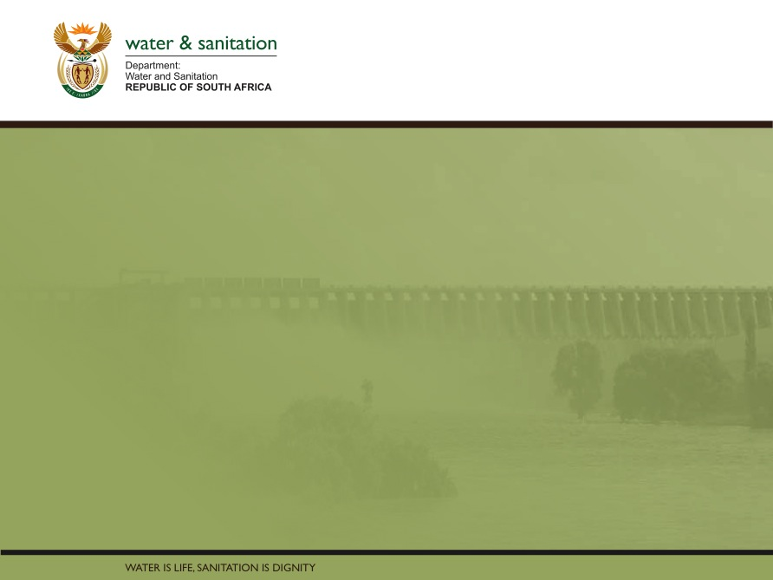
Classification, Reserve & RQO determination of water resources in the Mvoti to Umzimkulu Water Management Area
TECHNICAL PROGRESS
Delana Louw
Rivers for Africa
16 September 2015
PRESENTATION TITLE
Presented by:
Name Surname
Directorate
Date

Slide 2
TERMINOLOGY
NOTE:
Water Resource Classes (correct terminology)
commonly referred to as
Management Classes

Slide 3
PROJECT PLAN & STUDY TASKS
TECHNICAL STEPS
Complete
In process
1. Status quo, IUA delineation
OTHER STEPS
3. Quantify EWRs
4. ID & evaluate scenarios in IWRM
2a Visioning
2b Stakeholder process
8. Gazetting
8. Capacity Building
5. Evaluate scenarios with stakeholders and determine MC
6. RQO

Slide 4
STEP 1: STATUS QUO & IUA DELINEATION
Task completed.
Purpose of task is to select homogenous areas that can be managed as an entity (IUA),
to determine the status quo of the IUAs, and
1. Status quo, IUA delineation
3. Quantify EWRs
4. ID & evaluate scenarios in IWRM
to determine hotspots to prioritise the RUs for RQOs amongst others.
The output in essence is a sustainable base configuration that equates to the present state.
Changes in this status are measured when evaluating operational scenarios within IWRM (Step 4).
29 IUAs identified, each with nodes.

Slide 5
  STEP 3: QUANTIFY EWRS
1. Status quo, IUA delineation
Purpose of task is to determine EWRs at each biophysical node.
Output is EWRs as flow duration tables for each node
All river & estuary surveys have been undertaken and EWRs determined
3. Quantify EWRs
4. ID & evaluate scenarios in IWRM
During previous meetings: Detailed EWRs presented at 12 EWR sites.
EWRs at 158 desktop biophysical nodes presented: Reports have been distributed for comments.
Estuary EcoClassification has been undertaken and recommended EWR been determined. Reports have been distributed.

Slide 6
  STEP 4 & 5: ID & EVALUATE SCs WITHIN IWRM
1. Status quo, IUA delineation
Determined preliminary operational scenarios and test with stakeholders.
3. Quantify EWRs
Determined consequences of scenarios for U1 and U4: River, estuary, economics, ecosystem services, yield. Ranking scenarios have taken place and draft MC provided
4. ID & evaluate scenarios in IWRM
5. Evaluate scenarios with stakeholders and determine WRC
Rest of study area addressed at this PSC meeting

Slide 7
  STEP 6: QUANTIFY RQOs
6. RQOs
Purpose of task is to determine RQOs for each moderate and priority RUs.
Level of detail & indicator components determined and differ between moderate and high priority river RUs.
River and wetland water quality, habitat and biota RQOs presented at previous PSC meeting.
Estuaries and groundwater presented at this PSC meeting.

Slide 8
  RECAP OF PROCESS TO DETERMINE WRC
Determine Status Quo
Identify operational scenarios
User water quality consequences
Determine EWR
EcoSystem Services consequences
Economic consequences
Ecological consequences
CHANGE FROM STATUS QUO? (PREDICT CONSEQUENCES)
Draft Management Classes for each Scenario
Select scenario
MANAGEMENT CLASS

Slide 9
  RECAP OF PROCESS TO DETERMINE WRC
Synthesize scenarios and associated MC, catchment configuration and trade-offs
Present and obtain input from stakeholders
Select scenario and draft MC
Recommended MC
RQOs for MC
DWA decision
Gazetting process
MC (& CATCHMENT CONFIGURATION) & RQOs GAZETTED

Slide 10
  TRAFFIC DIAGRAMS
  A traffic diagram is a bar graph that is shaded according to the colours of a traffic light.
  This implies that the items at the top (in the green section) is better than the ones below.
  The scale of the bar graph could be anything, the importance is the ranking of this.
  The purpose is to, in step 4 and 5, rank scenarios for all the different components using different scales of measurements, but visually being able to compare the rankings using traffic diagrams.

Slide 11
  QUESTIONS FOR CLARIFICATION

